Slide 1

Rank of a Matrix
Find the Rank using Row echelon form of the following matrix
$$\left[\begin{matrix}1 & 2 & 3 & −1 \\ −2 & −1 & −3 & −1 \\ 1 & 0 & 1 & 1 \\ 0 & 1 & 1 & −1\end{matrix}\right]$$

Slide 2
Nullity
The rank of A equals the number of nonzero rows in the row echelon form, which equals the number of leading entries. The nullity of A equals the number of free variables in the corresponding system, which equals the number of columns without leading entries
(No. of columns – rank =nullity)

Slide 3
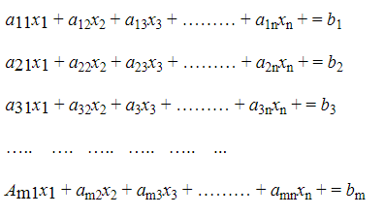
System of Linear Equations
System of Linear Equations in Matrix Form
A system of m linear equations in n unknowns is of the following form:
where the coefficients a_{ij} , i = 1, 2, …. , m; j = 1, 2,….., n and b_{k} , k = 1, 2,….., m are constants. If all the b_{k} 's are zeros, then the above system is called a homogeneous system of linear equations. On the other hand, if at least one of the b_{k} 's is non-zero, then the above system is called a non-homogeneous system of linear equations. If there exist values α₁ , α₂ , ….. , α_{n} for x₁, x₂ , …. , x_{n} respectively which satisfy every equation of (1), then the ordered n − tuple (α₁ , α₂ , …. , α_{n} ) is called a solution of (1).

Slide 4
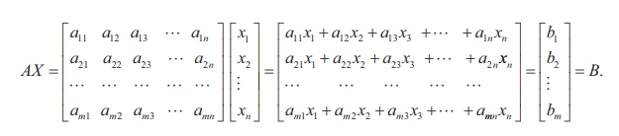
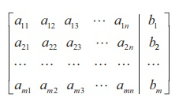
System of Linear Equations
AX = B is a matrix equation involving matrices and it is called the matrix form of the system of linear equations (1). The matrix A is called the coefficient matrix of the system and the matrix
is called the augmented matrix of the system. We denote the augmented matrix by [ A | B ].

Slide 5
System of Linear Equations
The Augmented Matrix of a Linear System
Linear System | Augmented Matrix
Notice that a missing variable in an equation corresponds to a 0 entry in the augmented matrix.

Slide 6
System of Linear Equations
Gaussian Elimination
To solve a system of linear equations using its augmented matrix, we use elementary row operations to arrive at a matrix in row echelon form.
Once an augmented matrix is in row-echelon form, we can solve the corresponding linear system using back-substitution.
Solve the system of linear equations.

Slide 7
System of Linear Equations
Gaussian Elimination
System | Augmented Matrix

Slide 8
System of Linear Equations

Slide 9
System of Linear Equations
Now, we use back-substitution to find that: x = 2, y = 7, z = 3
The solution is (2, 7, 3).

